Slide 1
MUTUAL FUND ANALYTICS
End-to-End Financial Data Analytics Platform
ETL • SQLite • SQL • EDA • Performance Analytics • Streamlit Dashboard • Automated Reporting
Bluestock Fintech Capstone Project
Final Presentation

Slide 2
Problem Statement & Objectives
The Problem
Project Objectives
▪ Mutual-fund data (NAV, AUM, SIP, investor, performance) arrives fragmented across sources.
▪ Each new question requires re-cleaning and re-joining the same data.
▪ No repeatable way to track how key metrics evolve over time.
▪ Build a reliable ETL pipeline: extract, clean, validate, load.
▪ Validate AMFI fund identifiers against NAV history coverage.
▪ Store processed data in a structured SQLite dimension/fact schema.
▪ Perform EDA, performance and advanced risk analytics on 40 schemes.
▪ Deliver an interactive Streamlit dashboard.
▪ Automate live NAV updates, weekly reporting and email delivery.
Mutual Fund Analytics • Bluestock Fintech Capstone
2

Slide 3
Project Architecture
Data Sources
Extract
Transform
SQLite
Analyse
Dashboard
Report
Automate
The master pipeline (run_pipeline.py) orchestrates the full sequence — from raw source files through SQLite storage and analytics to the Streamlit dashboard, weekly report and automated email — executed end-to-end via Python subprocess and triggered on a schedule.
Mutual Fund Analytics • Bluestock Fintech Capstone
3

Slide 4
Data Sources & Dataset
40 / 40
Validated Schemes (0 missing codes)
≈46,000
Historical NAV Records
2022–2026
Coverage Period
10
Datasets Used
▪ AMFI reference data + supplied project datasets + mfapi.in for selected live NAV.
▪ Fund master (40 schemes), historical NAV (~46K records, 2022-01-03 to 2026-05-29), AUM by fund house, monthly SIP inflows, category inflows, folio counts, scheme performance, portfolio holdings and benchmark indices.
▪ Investor transaction data used for demographic/geographic analysis is synthetic and generated for educational analysis — not sourced from real investor records.
Mutual Fund Analytics • Bluestock Fintech Capstone
4

Slide 5
ETL Pipeline
data_ingestion.py
Extracts raw source data
data_cleaning.py
Cleans, types, validates
load_database.py
Loads into SQLite
run_pipeline.py
Orchestrates via subprocess
▪ Cleaning covers date parsing, type correction, missing-value handling, validation and standardisation.
▪ Processed datasets are joined on AMFI code / scheme name for downstream calculations (returns, CAGR, Sharpe, Sortino, Alpha, Beta, VaR, CVaR, sector HHI).
▪ weekly_email_report.py generates the recurring HTML report and dynamic email summary from the current database state.
▪ Running run_pipeline.py end-to-end refreshes live NAV, updates SQLite, regenerates the report and sends the email — enabling unattended scheduled execution.
Mutual Fund Analytics • Bluestock Fintech Capstone
5

Slide 6
Database Design & SQL
dim_fund
Reference
fact_nav
NAV
fact_aum
AUM
fact_performance
Risk / Return
fact_transactions
Investor
fact_sip
SIP
40
Fund-master AMFI codes
40
NAV-history AMFI codes
0
Missing codes
▪ Dimension/fact schema: dim_fund is the shared reference table joined by AMFI code to each fact table.
▪ SQL queries support fund counts, fund-house summaries, AUM/NAV/SIP analysis, transaction analysis and the filters used throughout the dashboard.
▪ The 40/40/0 validation result confirms every scheme in the fund master has corresponding NAV history.
Mutual Fund Analytics • Bluestock Fintech Capstone
6

Slide 7
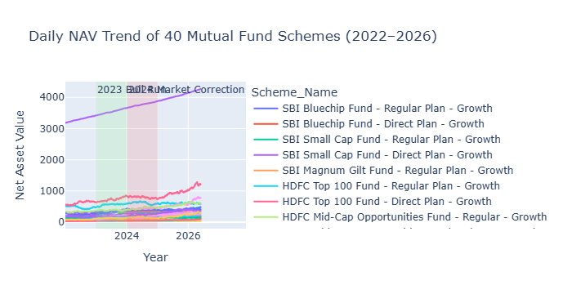
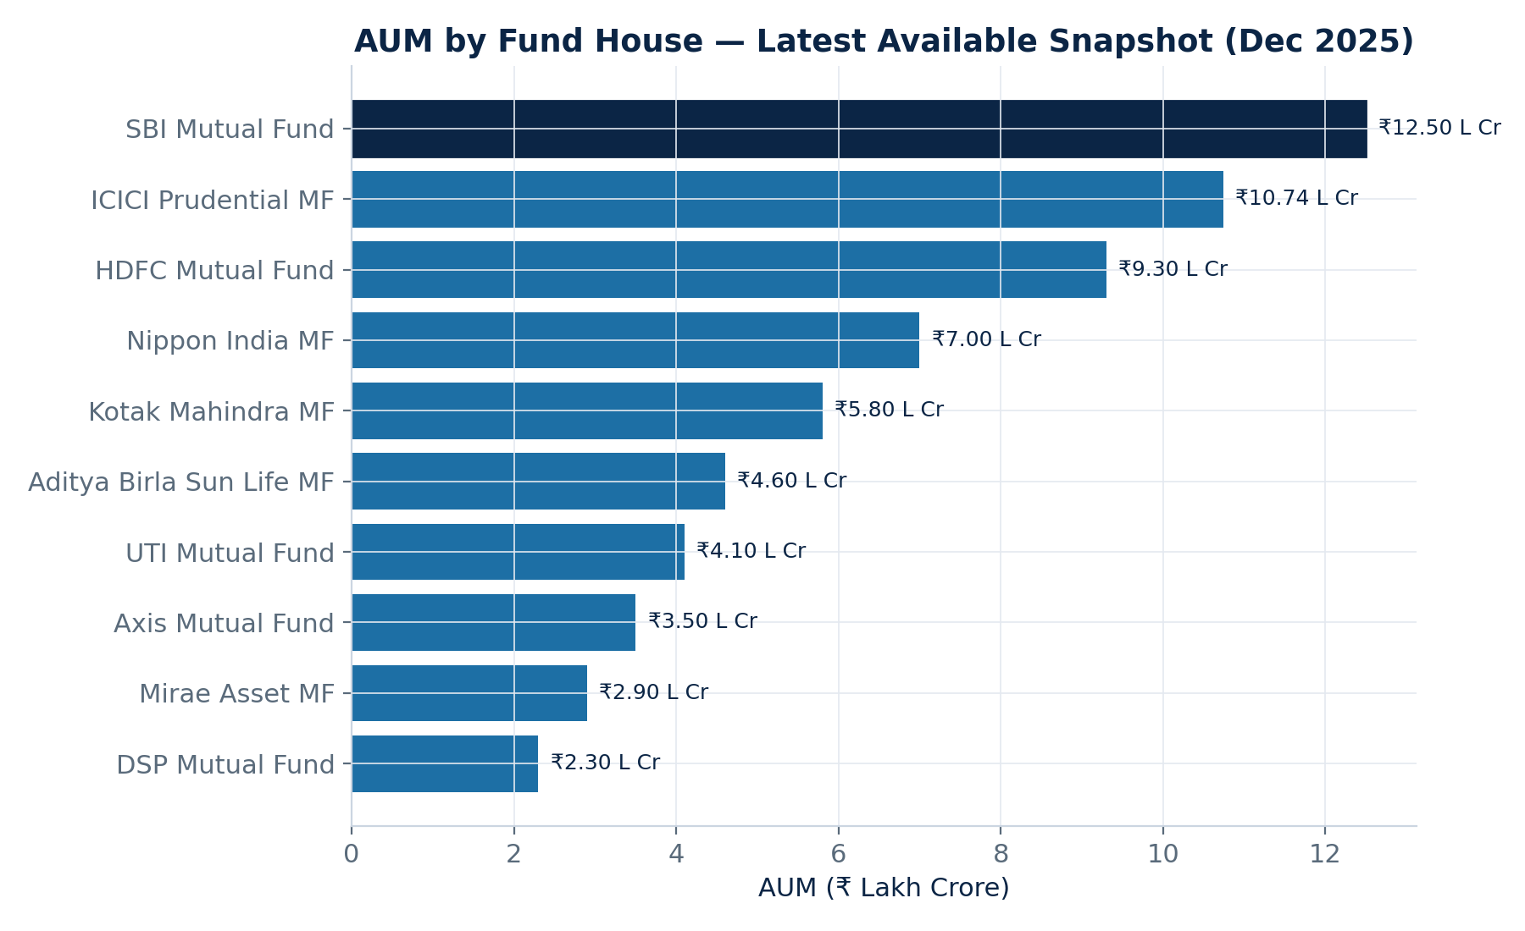
EDA & Major Analytics
Daily NAV Trend — 40 Schemes, 2022–2026
AUM by Fund House — Latest Snapshot
▪ NAV trends, AUM growth, SIP inflows, category inflows, investor demographics, folio growth, NAV-return correlation and sector allocation — all computed from the project's processed datasets.
▪ SBI Mutual Fund leads the displayed fund houses on AUM at the latest snapshot.
Mutual Fund Analytics • Bluestock Fintech Capstone
7

Slide 8
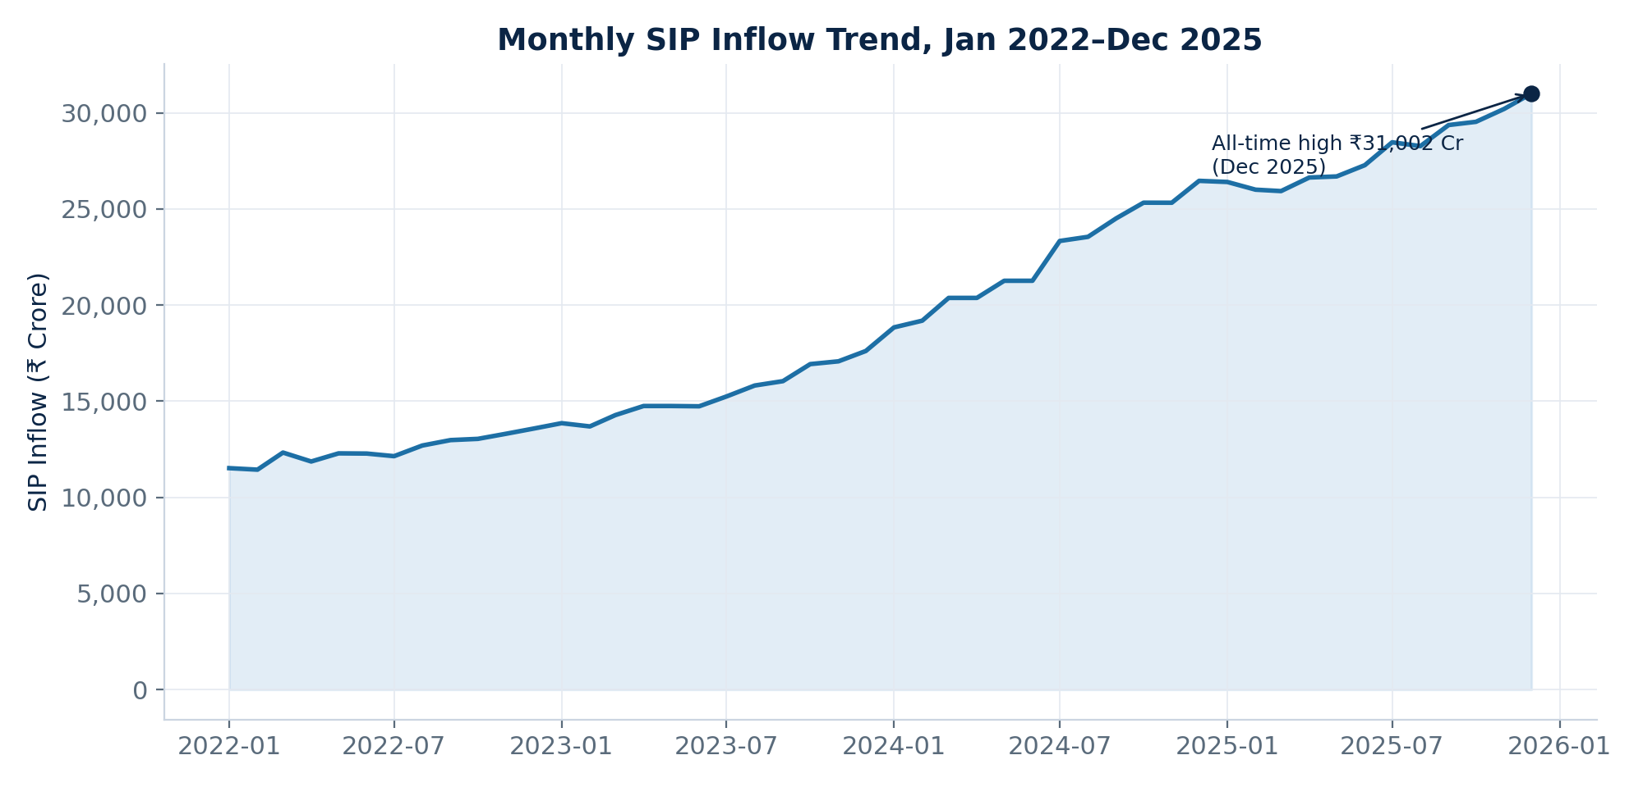
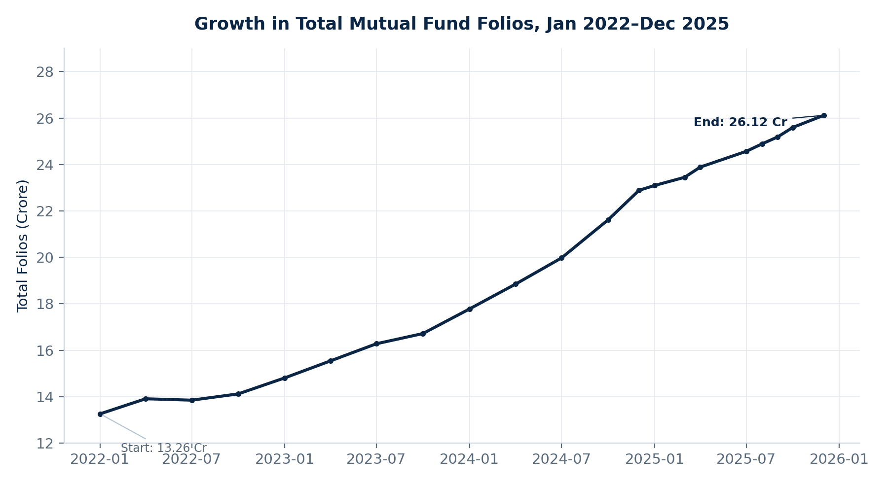
AUM & SIP Insights
Monthly SIP Inflow Trend
Growth in Total Mutual Fund Folios
▪ SIP inflows trend upward across the period, peaking at an all-time high of ₹31,002 Cr.
▪ Total folios grow from 13.26 Cr to 26.12 Cr between January 2022 and December 2025.
Mutual Fund Analytics • Bluestock Fintech Capstone
8

Slide 9
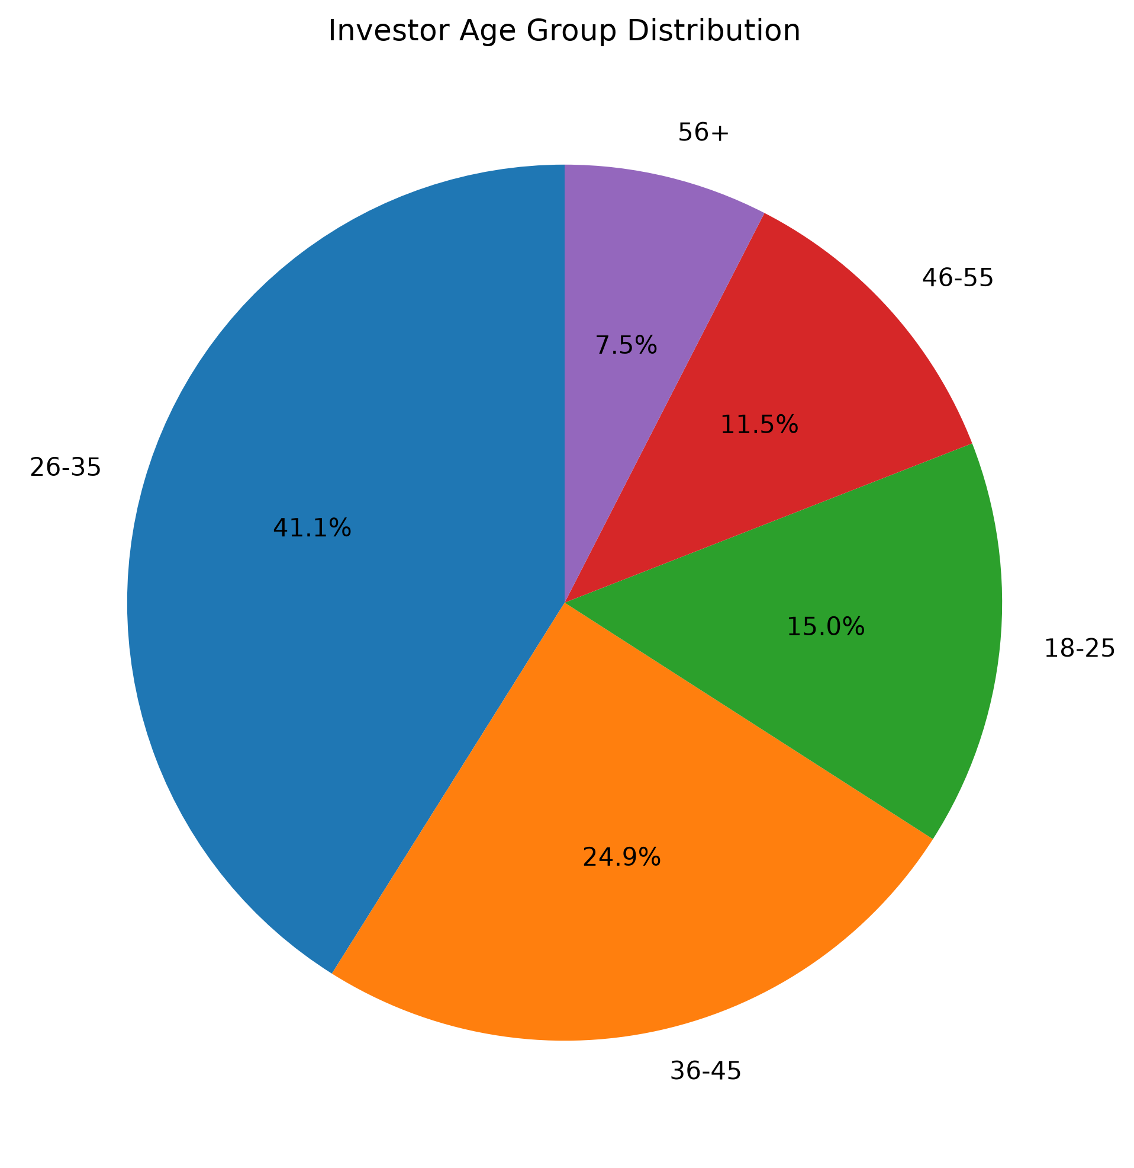
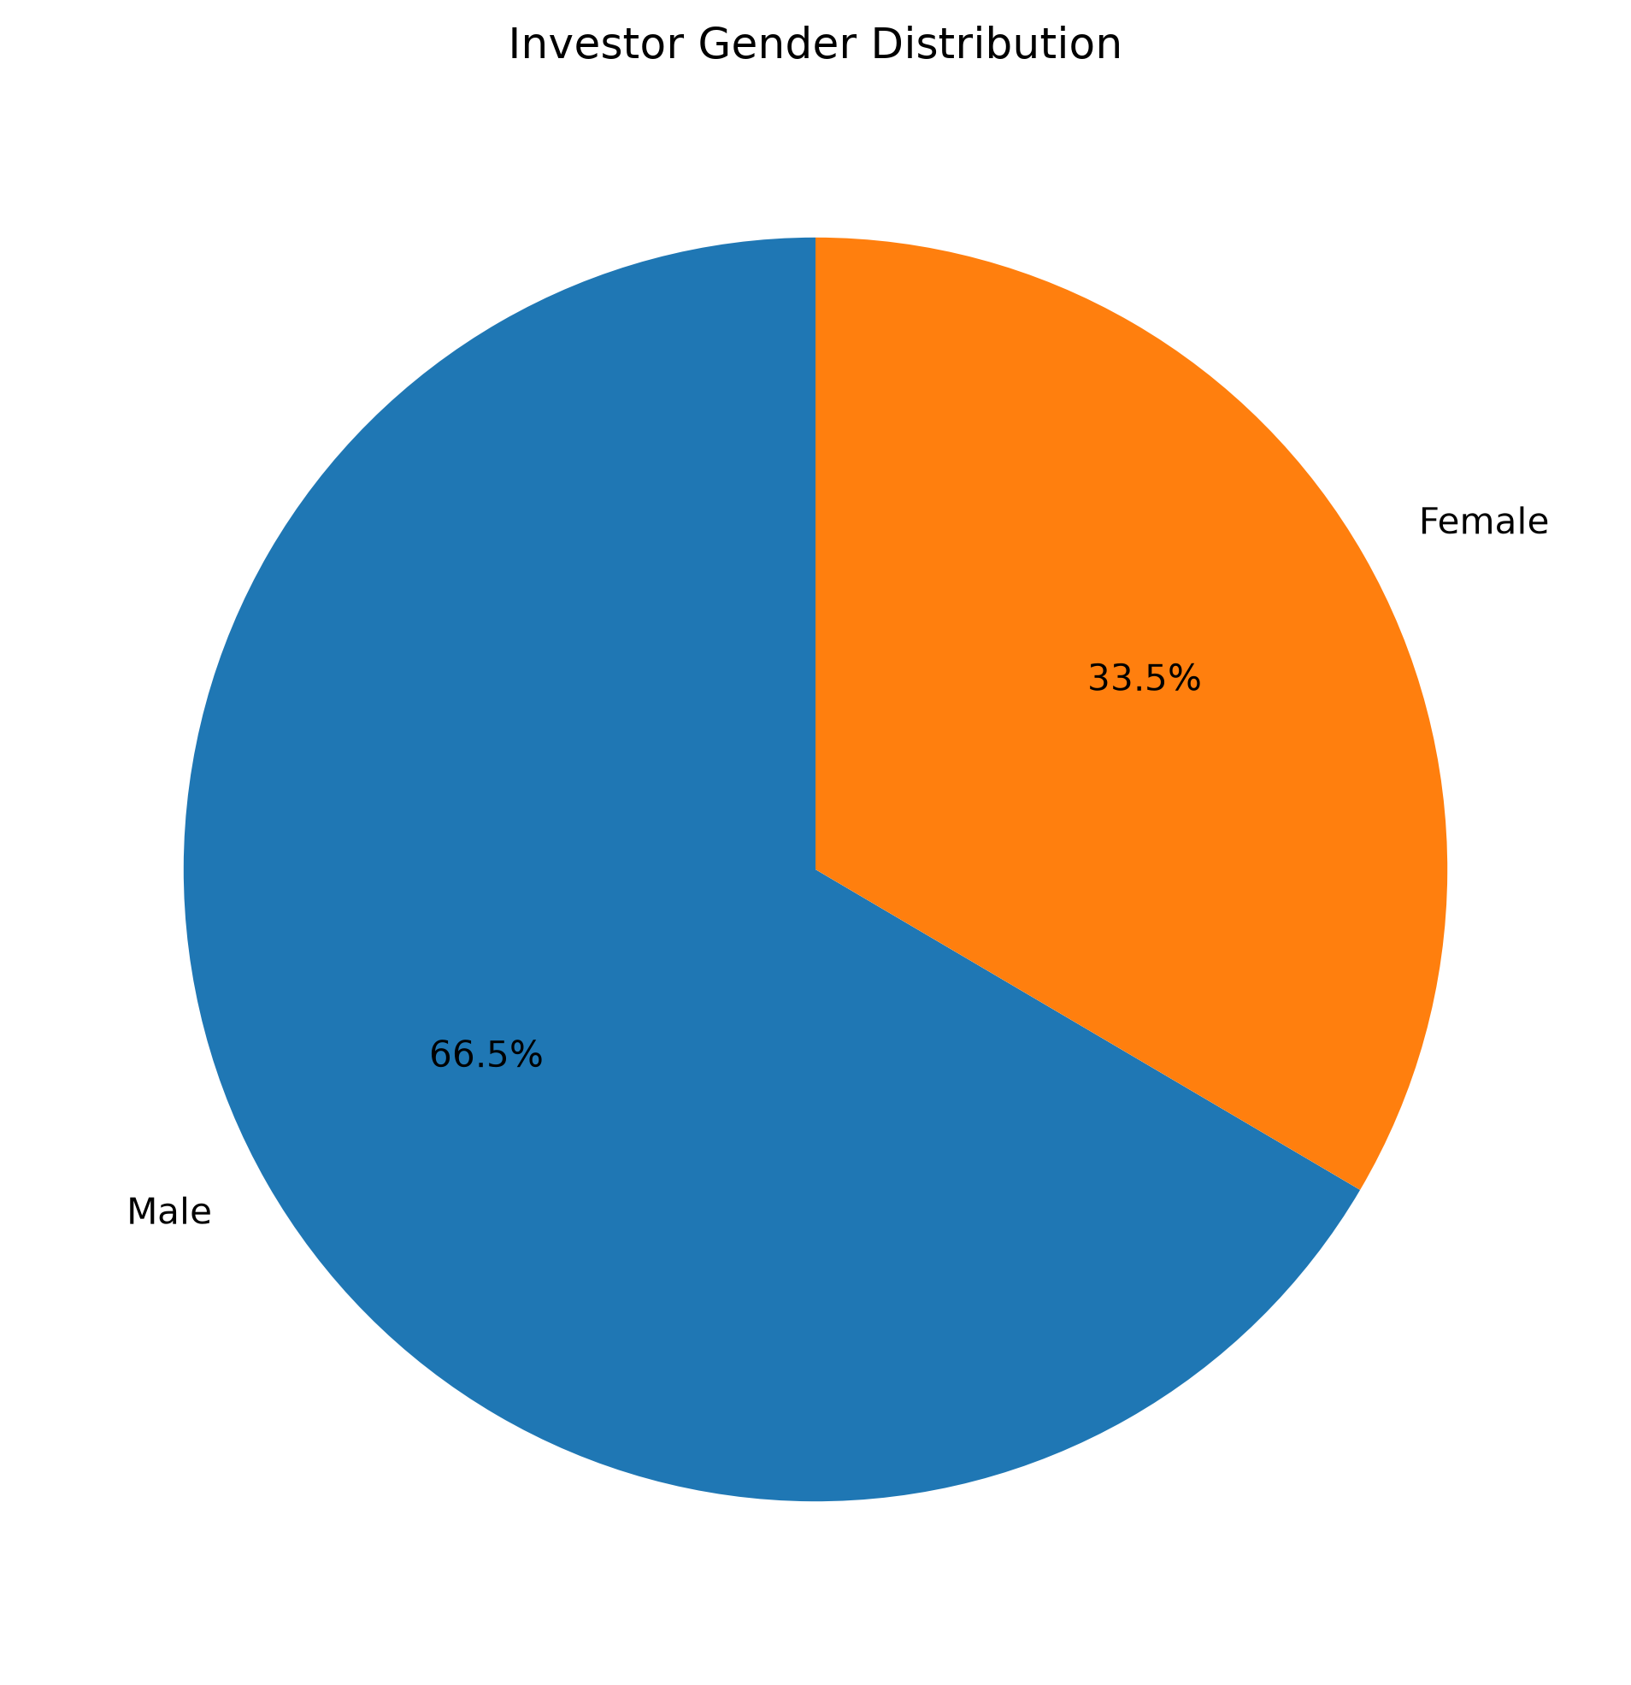
Investor Demographics
▪ 26–35 is the largest displayed age segment at approximately 41.1%.
▪ Male investors represent approximately 66.5%; female investors approximately 33.5% (synthetic dataset).
▪ T30 cities contribute more total SIP investment than B30 cities in the analysed project data.
Mutual Fund Analytics • Bluestock Fintech Capstone
9

Slide 10
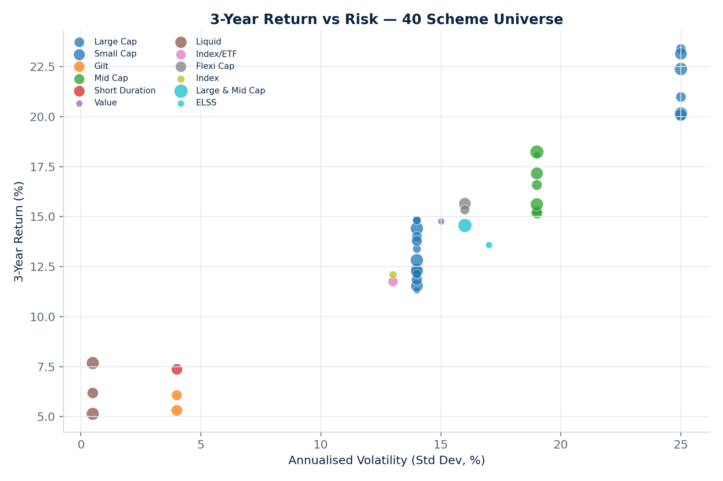
Fund Performance & Risk
▪ 1Y / 3Y / 5Y returns where applicable
▪ Sharpe & Sortino ratios
▪ Alpha & Beta vs benchmark
▪ Annualised volatility & maximum drawdown
▪ Historical 95% VaR & CVaR
▪ Fund Performance Scorecard — composite fund_score & risk grade
▪ Small/mid-cap schemes cluster at higher return & higher risk; gilt and large-cap sit at the lower-risk end.
Mutual Fund Analytics • Bluestock Fintech Capstone
10

Slide 11
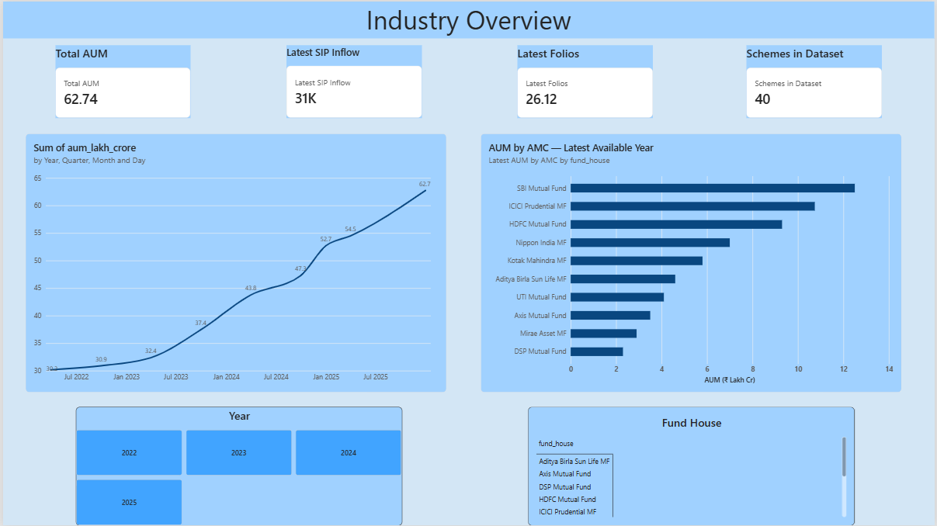
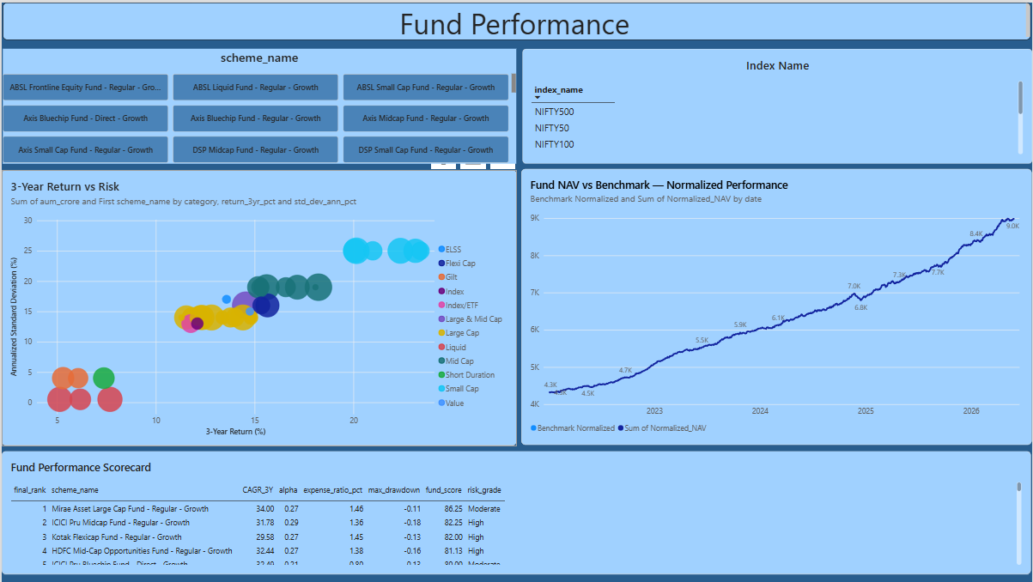
Interactive Streamlit Dashboard
Industry Overview
Fund Performance
▪ SQLite-backed; four pages — Industry Overview, Fund Performance, Investor Analytics, SIP & Market Trends.
▪ Fund-house, year and category filters, with cached/on-demand loading for responsive exploration.
Mutual Fund Analytics • Bluestock Fintech Capstone
11

Slide 12
Automation & Email Reporting
▪ run_pipeline.py orchestrates the recurring workflow: ingestion → cleaning → load → weekly report → email.
▪ Windows Task Scheduler task MutualFundAnalytics_ETL launches run_pipeline.py with the project root as the working directory.
▪ VS Code does not need to remain open; the machine must be powered on and able to execute the scheduled task.
▪ Resend is used for email delivery; external-recipient delivery depends on sender/domain configuration.
▪ Email content focuses on a dynamic summary and KPIs rather than depending on chart images rendering in mobile clients.
Observed automation test output:
“Live NAV updated. SQLite database updated. Weekly report generated. Email sent successfully.”
Mutual Fund Analytics • Bluestock Fintech Capstone
12

Slide 13
Key Findings & Business Insights
Key Findings
Business Insights
▪ 40/40 AMFI validation with zero missing codes.
▪ 26–35 is the largest displayed age segment (≈41.1%).
▪ Male investors ≈ 66.5% of the analysed synthetic dataset.
▪ SIP inflows peak at ₹31,002 Cr; folios rise 13.26 → 26.12 Cr.
▪ SBI Mutual Fund leads displayed AUM at ≈₹12.5 L Cr.
▪ Fund Performance Scorecard supports first-pass fund screening.
▪ VaR/CVaR and sector-HHI outputs flag elevated risk / concentration.
▪ Demographic findings can inform distribution strategy.
▪ Automated weekly report keeps KPIs current without manual rebuilding.
▪ Category inflow view shows where investor money is currently flowing.
Mutual Fund Analytics • Bluestock Fintech Capstone
13

Slide 14
Challenges & Solutions
Data fragmentation
ETL pipeline + SQLite analytical layer
Data-quality risk
AMFI-code validation & standardisation (40/40/0)
Comparing funds fairly
Standardised risk/return metrics & scorecard
Dashboard responsiveness
Caching & on-demand loading, avoiding startup overload
Unattended recurring reporting
Scheduled pipeline via Windows Task Scheduler
Mobile email rendering
KPI/summary-first email design, not chart-dependent
Mutual Fund Analytics • Bluestock Fintech Capstone
14

Slide 15
Conclusion & Future Scope
▪ Complete workflow: data → ETL → SQLite → analytics → dashboard → reporting → automation.
▪ Demonstrates practical Python, SQL, financial analytics, dashboard development and automation skills.
▪ Current implementation is local and educational — not a production financial platform.
Future Scope
▪ PostgreSQL for production-scale, multi-user operation
▪ Public dashboard deployment with authentication
▪ Broader live-NAV coverage, cloud scheduling & monitoring
Mutual Fund Analytics • Bluestock Fintech Capstone Project — Thank You

